Slide 1

SINGLE AXIS SOLAR TRACKING SYSTEM
B.M.S COLLEGE OF ENGINEERING
Bull Temple Road, Basavanagudi , Bangalore - 560 019, Karnataka, India
TEAM MAMBERS
Subramanya K - 1BM18EC154
Suraj S - 1BM18EC160
V .A .R. Karthik - 1BM18EC174
Sukshith B Jain - 1BM18EC156
Under the guidance of
Assistant Professor
Pooja A P
MINI PROJECT
2019 – 20
DEPARTMENT OF ELECTRONICS AND COMMUNICATION ENGINEERING

Slide 2
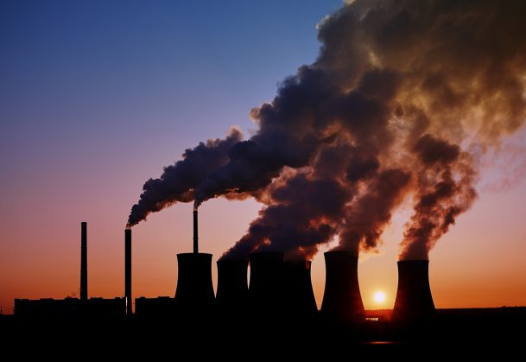

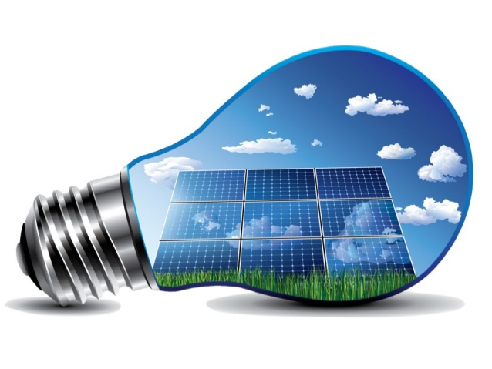
INTRODUCTION
In the present world pollution is the main Problem.
If we keep burning fossil fuels at our current rate, it is estimated that all our fossil fuels will be depleted by 2060.
Solar energy is solution
for this problem.
Lots of work is going to improve the efficiency of solar power.

Slide 3
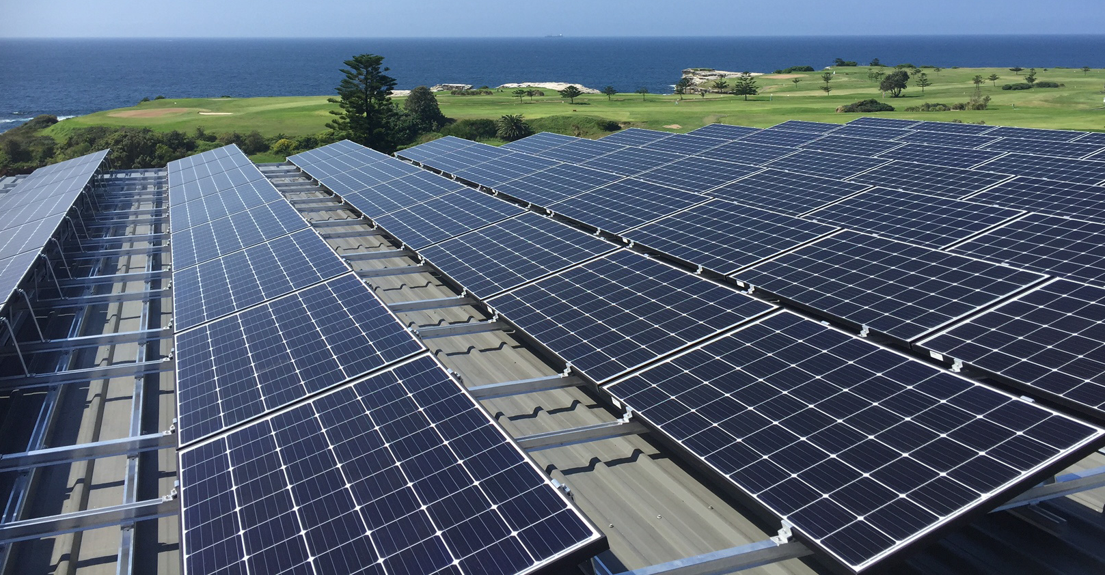
SCOPE OF THE PROJECT
Renewable energy provides reliable power supplies and fuel diversification, which enhance energy security and lower risk of fuel spills while reducing the need for imported fuels.
IMPORTANCE:
Photovoltaic solar panels
absorb sunlight as a source of energy to generate
direct current electricity.
Solar power is pollution free and causes no greenhouse gases to be emitted after installation
and no generation losses
Fig: Solar harvesting

Slide 4
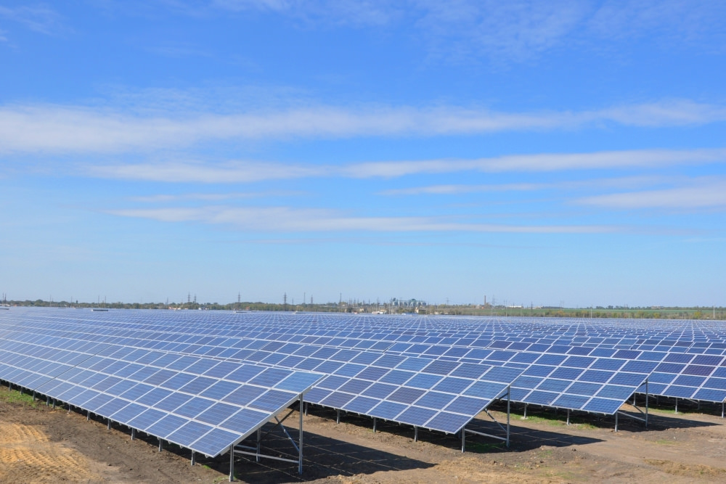

PROBLEM DEFINITION
Although solar energy can still be collected during cloudy and rainy days, the efficiency of the solar system drops.
Solar panels are in fixed position and wasting sunlight
Solar PV panels require a lot of space and efficiency is restricted to 11-15%
Fig: Solar Tracker
OBJECTIVES:
More energy is to absorbed and can be converted into power and increase its efficiency.
Larger area and less productivity
RESEARCH AREAS:
Power System Planning and Operation with High Penetrations of PV
Fig: Neural network

Slide 5
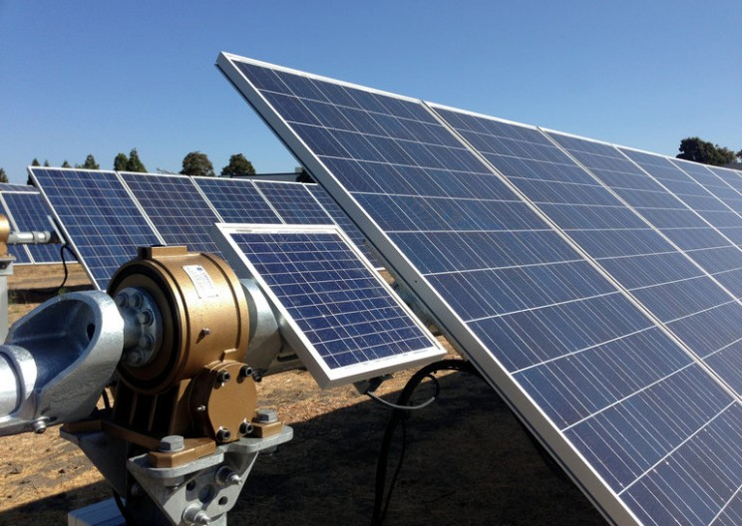
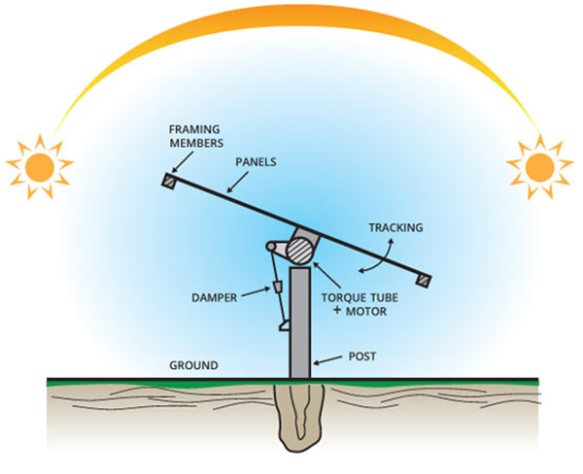
PROPOSED SOLUTION
SOLAR TRACKING
Solar tracker, a system that positions an object (solar panel) at an angle relative to the Sun.
PV solar trackers adjust the direction that a solar panel is facing according to the position of the Sun in the sky perpendicularly.
A Solar tracker will make a solar panel around 40 percent more efficient.
(60-80)% of efficiency

Slide 6
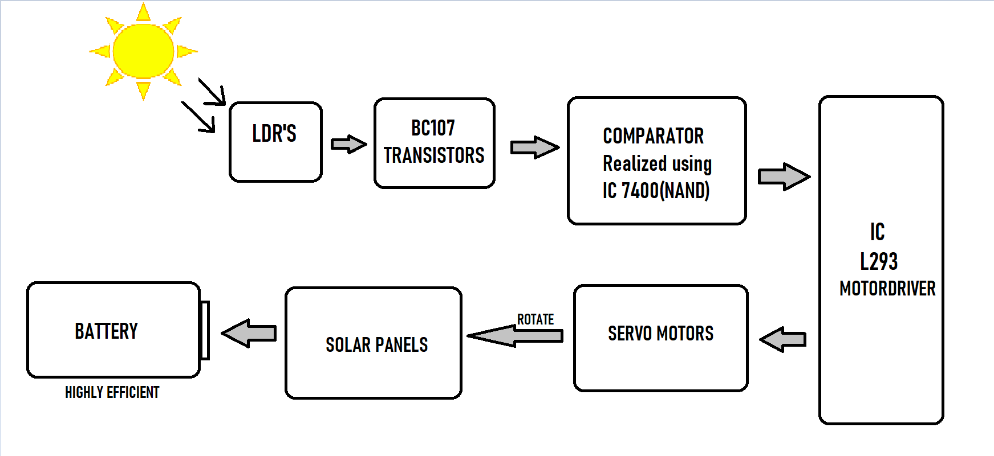
BLOCK DIAGRAM

Slide 7
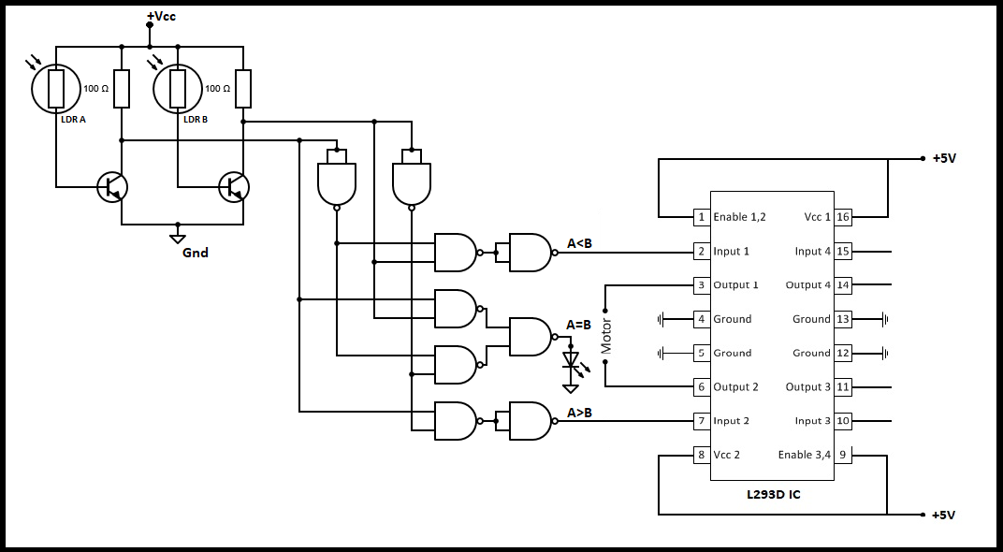
CIRCUIT DIAGRAM

Slide 8
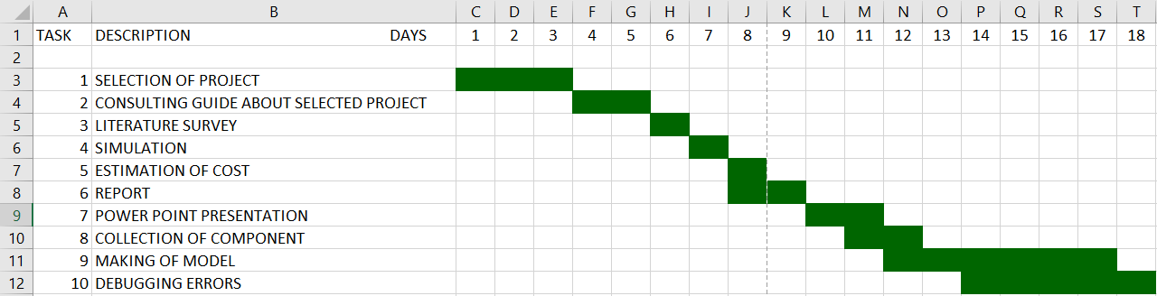
PROJECT PLANNING

Slide 9
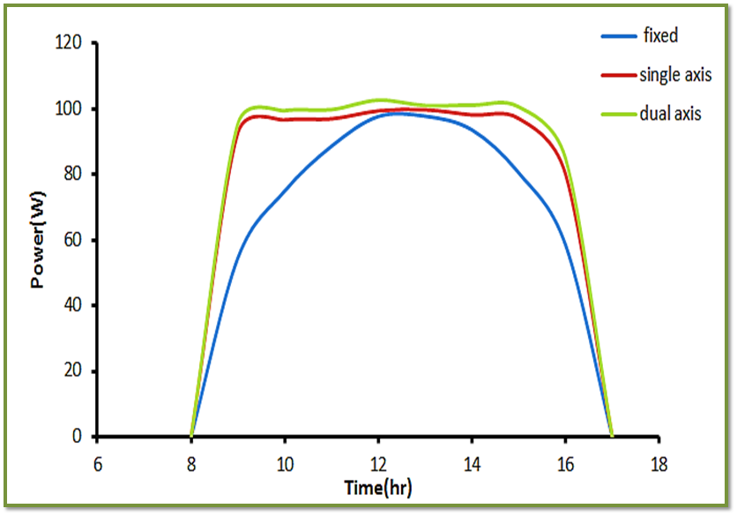
EXPECTED OUTCOMES
Solar tracker is used as a renewable source of energy
This increase can be as much as 20 to 45% depending on the geographic location of the tracking system

Slide 10
BUDGET AND PATENTS
PATENTS:
INVENTOR: José Abel González Moreno, Fustifiana (ES)
ASSIGNEE: Mecanizados Solares, S.L., Fustinana (Navarra) (ES)
ESTIMATED BUDGET:
For a standard 4KW system, A axis tracker system costs about Rs 15,40,000 /-
Budget for building the solar tracker for the project is Rs 1000/-

Slide 11
REFERENCE (LITERATURE SURVEY) DETAILS
http://wgbis.ces.iisc.ernet.in/biodiversity/sahyadri_enews/newsletter/issue45/bibliography/Increasing%20the%20solar%20photovoltic%20energy%20capture%20on%20sunny%20and%20cloudy%20days.pdf
http://eprint.iitd.ac.in/bitstream/handle/2074/1708/saxenaver1990.pdf?sequence=2&isAllowed=y
https://www.researchgate.net/publication/3359957_Microprocessor_based_automatic_Sun_tracker
https://www.tandfonline.com/doi/abs/10.1080/01425919808914341
https://www.researchgate.net/publication/3280078_Development_of_a_Microcontroller-Based_Photovoltaic_Maximum_Power_Point_Tracking_Control_System
https://www.researchgate.net/publication/320086210_Solar_Tracking_Techniques_and_Implementation_in_Photovoltaic_Power_Plants_a_Review

Slide 12
THANK YOU

